Slide 1
SmartSlitter
Created Sep. 17, 2015
Horizon International Inc.

Slide 2
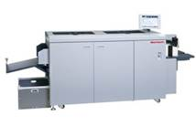
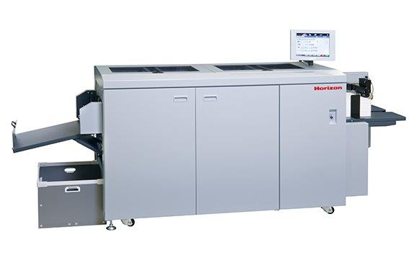
About SmartSlitter
SmartSlitter does
Slitting
Creasing
Perforating
Cutting

Slide 3
How does Smart Binding System work
Let’s watch a product video
Notes:
ここでSmart Binding Systemのビデオを流す

Slide 4
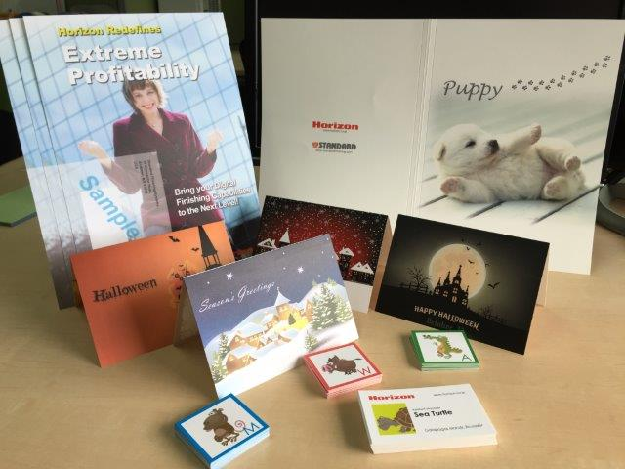
Target Application
SmartSlitter can produce
Coupons
Greeting cards
Business cards
Other Card applications
Restaurant menu
Perfect Bind cover
*Samples of SmartSlitter
Notes:
アプリケーションのサンプルをみんなに配る（質問は後から受け付ける）

Slide 5
Target Market
SmartSlitter can go into
Short-run digital print
Advertising agencies
General Commercial Print
In-plants
*Samples of SmartSlitter

Slide 6
Function
1. Creasing
2. Perforating
3. Slitting
4. Cutting

Slide 7
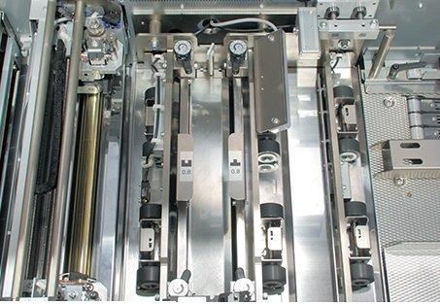
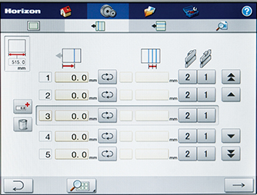
Function
1. Creasing
Cross-direction
Two impact creasing units (positive and negative) are equipped as standard. (same units as in CRF-362)
Creasing depth can be adjusted by simple dial knobs.
Up to 20 creasing lines can be performed per sheet.
Minimum creasing distance is 5mm. (0.196’’)
Standard creasing width : 0.8mm (0.031’’)

Slide 8
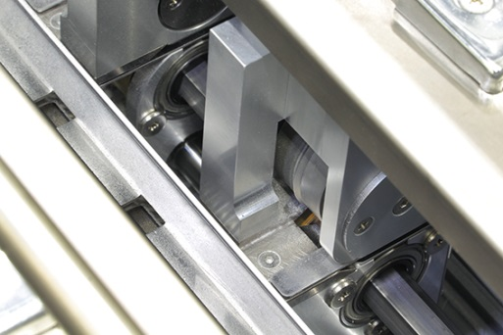
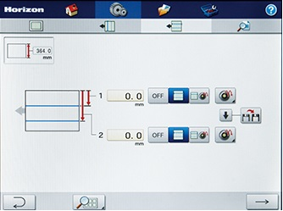
Function
1. Creasing
Sheet feed direction
2 sets of rotary scoring units are equipped.
Changeover can be done fully automatically through touch panel.
Scoring width : 0.8 mm (0.031’’)
Minimum scoring distance : 90 mm (3.55’’)

Slide 9
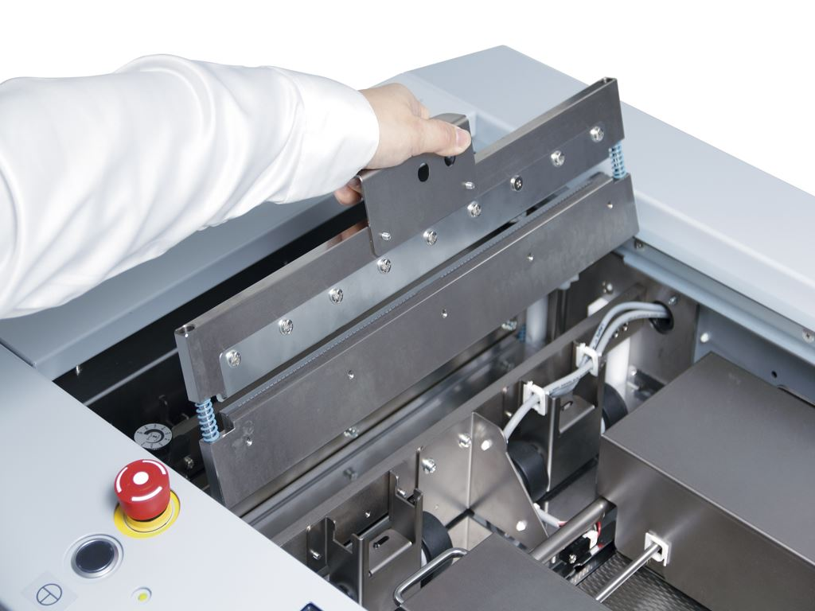
Function
2. Perforating
Cross-direction (Option)
Impact perforation unit, PRF-36, performs perforation by replacing with the creasing unit.
Partial perforation can be performed by replacing perforation blade.
Perforation blade and cutting stick can be replaced with simple procedure.

Slide 10
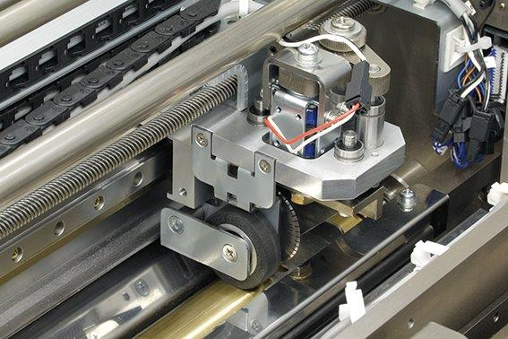
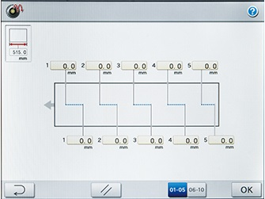
Function
2. Perforating
Sheet feed direction (Option)
2 sets of rotary perforation units are equipped.
Perforation position can be adjusted automatically.
Skip perforation enables T-shaped and L-shaped perforation.
Skip perforation can be performed maximum 10 times per sheet.
Minimum gap between perforation lines is 50 mm (2.16’’).
Notes:
サンプルを見せる。

Slide 11
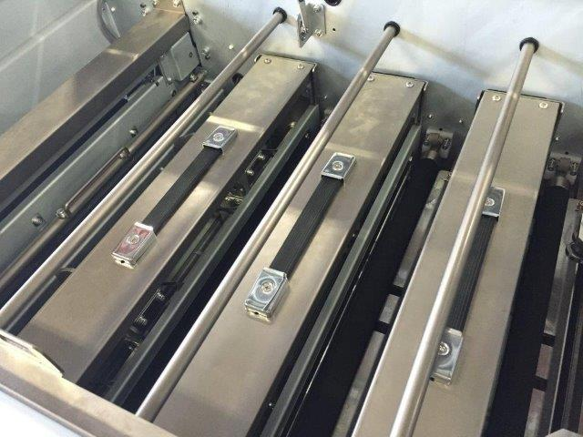
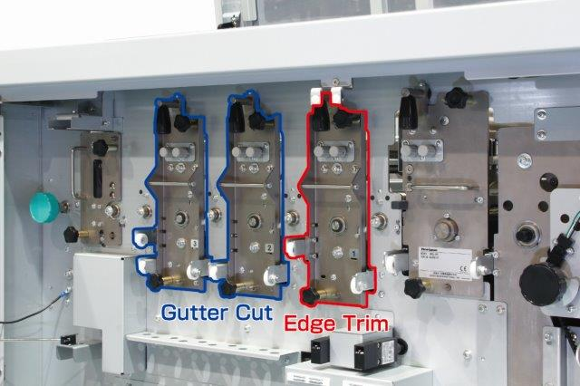
Function
3. Slitting
Sheet feed direction
4 slitter cutters for 2 gutter cuts or 2 slit cuts.
2 slitter cutters for edge trim.
Edge trimming width
3 to 60 mm (0.118’’ x 2.362’’)
Gutter cutting width :
5 to 15 mm (0.196’’ x 0.590’’)

Slide 12
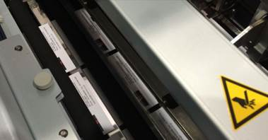
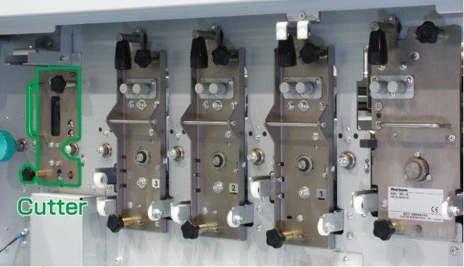
Function
4. Cutting
Cross-direction
Scissors type cutting with upper and lower blades is employed.
Cutter activates maximum 20 times per sheet.
Gutter cut can be performed. Gutter width is 5 to 20mm (0.196’’ to 0.787‘’)

Slide 13
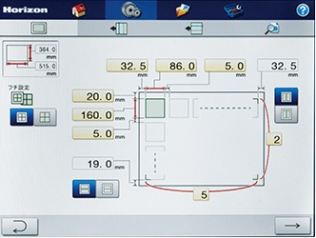
Touch panel
Intuitive touch screen and easily input sheet size, slit, edge trim, perforation and cutting position. Then whole section of the SmartSlitter can be adjusted automatically.
High resolution 12.1 inch touchscreen.
200 jobs can be stored in job memory.

Slide 14
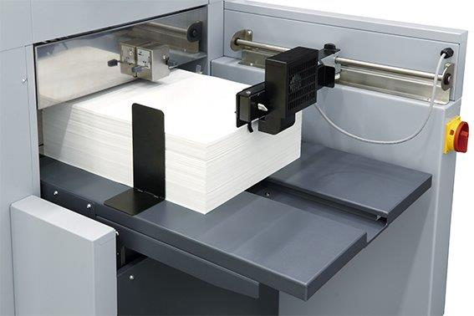
Sheet feeder
Vacuum belt, and powerful separation air ensures consistent and smooth feeding.
Built-in ultra-sonic sensor detects double feeding and miss-feeding.
Same technology as in RD-4055.

Slide 15
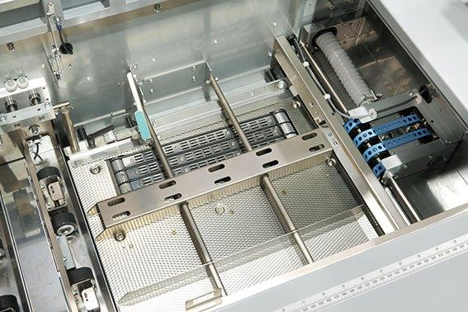
Sheet registration
Sheet alignment
Sheets are aligned to the register guide by angled vacuum belt.
Sheets are firmly transported with gripper rollers for high precision sheet positioning.
Sheets are accurately positioned to camera section so that camera can steadily scan barcode printed on sheet.

Slide 16
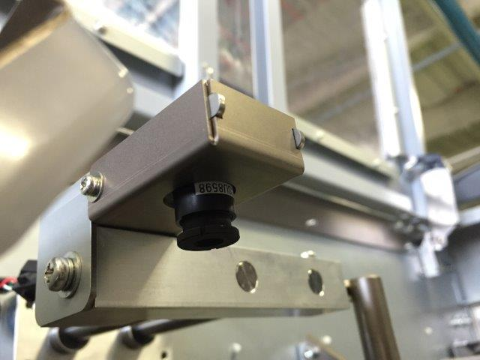
Camera Unit (Option)
Auto Sheet Registration
Camera scans register mark printed on each sheet.
Following sections will be fine adjusted according to scanned register mark position.
Slitting section
Scoring section
Cutting section
Perforation section
Notes:
Both cross-direction and sheet feed-direction can be adjusted

Slide 17
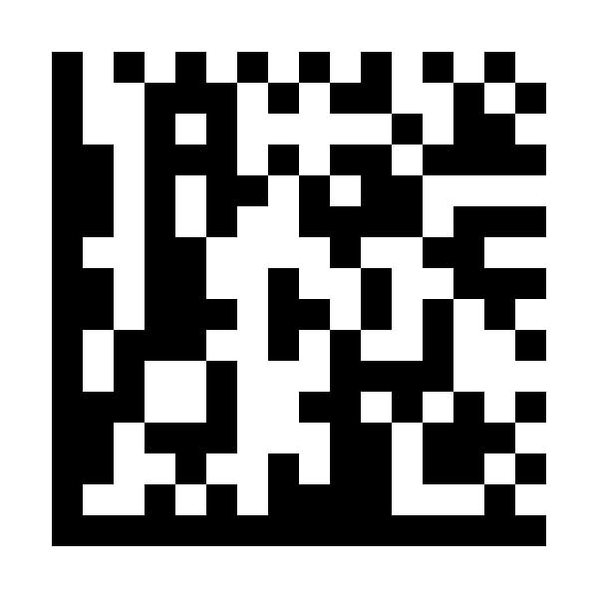
Camera Unit (Option)
Type of Register Mark
Following prints can be utilized as register mark.
1D : CODE39, CODE128
2D : QR code, DataMatrix
L-shaped mark
Square mark
Notes:
Check skewed correction.

Slide 18
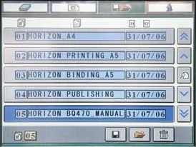
Camera Unit (Option)
Job Memory Recall
M003
M003
1D & 2D Barcode can be used to recall the job from job memory.
*Picture above is that of BQ-470.

Slide 19
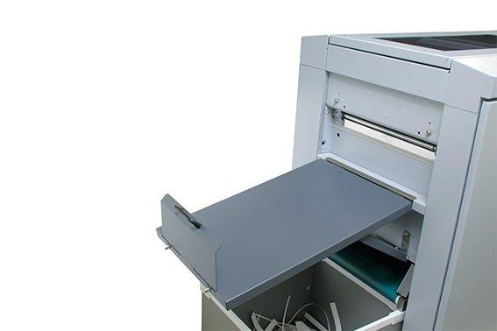
Delivery
a. Standard Receiving Tray
Simple receiving tray is equipped as standard tray.
Maximum stack height :
150mm (5.90’’)

Slide 20
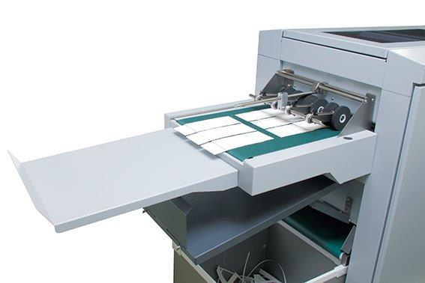
Delivery
b. Delivery Conveyor (Option)
Wide-belt type delivery conveyor.
Preset function can control the belt speed for job separation purpose.
Conveyor drive time can be adjusted.

Slide 21
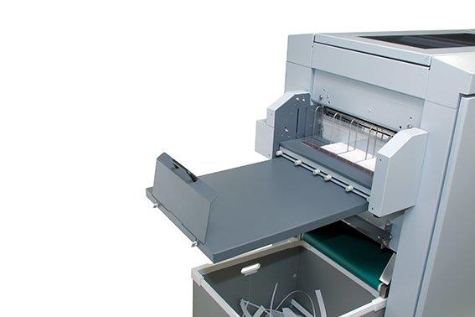
Delivery
c. Card Stacker (Option)
Card stacker can pile multiple up application such as business card and coupon card.
Descending type stacker.
Maximum stacking height is 90 mm (3.543’’)
Maximum card size : 370×150 mm (14.56"×5.90”)
Minimum card size : 48 x 50 mm (1.89"×1.97")

Slide 22
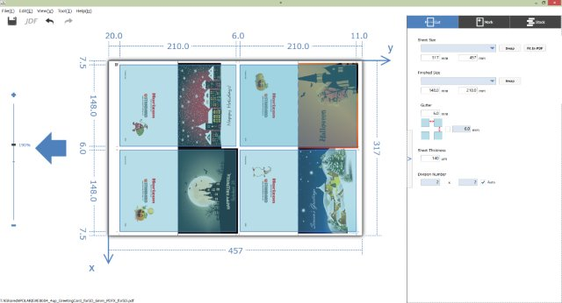
SmartConnect (Option)
SmartConnect is…
software application to simplify set up operation of SmartSlitter and can connect to JDF workflow. pXnet is not required.
*Setup screen of SmartConnect
Notes:
The purpose is to workflow.

Slide 23
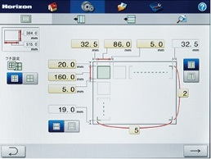
SmartConnect (Option)
Normal Setup
Touch Panel
Setup on panel manually
Start changeover
Notes:
パネルからでもPCからでも結局は現物を見て手入力するという作業は変わらない。
SmartConnectのターゲットは、上位とJDFの連携を行い、自動で設定を行いたい人向け。
連携の方法はバーコード。SmartSlitter用のJDFを生成する為にはもちろんSmartSlitterの仕様を熟知する必要がある。

Slide 24
SmartConnect (Option)
SmartConnect Setup (PC required)
Add additional information with PC
Start changeover
Converting
Converting
Start changeover
Notes:
パネルからでもPCからでも結局は現物を見て手入力するという作業は変わらない。
SmartConnectのターゲットは、上位とJDFの連携を行い、自動で設定を行いたい人向け。
連携の方法はバーコード。SmartSlitter用のJDFを生成する為にはもちろんSmartSlitterの仕様を熟知する必要がある。

Slide 25
SmartConnect (Option)
SmartConnect simplifies
Set up procedure of SmartSlitter by use of PDF/JDF file,
Communication with upstream JDF workflow,
Creation of barcode for automated job recall.
Notes:
The purpose is to workflow.

Slide 26
5. Major Specification
General specification
Sheet size | Max : 370mm x 670mm (14.56’’x 26.37’’) Min : 210mm x 210mm (8.27’’ x 8.27’’)
Finished sheet size | Max : 370mm x 670mm (14.56’’ x 26.37’’) Min : 48mm x 50mm (1.89’’ x 1.97’’)
Paper weight | Uncoated : 80 to 350gsm (80 to 209gsm when PRF-36 is used) Coated : 105 to 350gsm (128 to 256gsm when PRF-36 is used)
Production speed | 55 sheets/min (A4 2 cutting with 1 crease) 50 sheets/min (B3 2 cutting with 1 crease)
Voltage | Single phase 200 to 240V 50/60Hz
Notes:
表にする

Slide 27
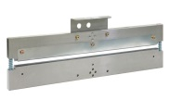
5. Major Specification
Creasing
Cross-direction
Max number of creasing | 20 times/sheet
Minimum distance | 5mm(0.196’’)
Creasing width | 0.8mm (0.031’’)
Sheet feed direction
Scoring wheel width | 0.8mm (0.031’’)
Minimum scoring distance | 90mm (3.55’’)

Slide 28
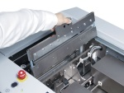
5. Major Specification
Perforation
Cross-direction
Max number of creasing | 20 times/sheet
Minimum distance | 5mm(0.196’’)
Creasing width | 0.8mm (0.031’’)
Sheet feed direction
Minimum perforation distance | 50mm (2.16’’)
Max skip perforation | 10 times/sheet
Creasing width | 0.8mm (0.031’’)

Slide 29
5. Major Specification
Registration camera
Reading area | 48 x 36mm (1.88’’ x 1.41’’)
Available barcode type | 1D : CODE39, CODE128 | 2D : QR code, DataMatrix
Available register mark | L shaped | Square shape
2.5mm or more
0.3mm square or more
2.5mm or more
5.5mm or more
5mm or more
5mm square or more

Slide 30
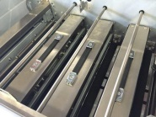
5. Major Specification
Slitting
Max slitting imposition | 3 ups
Edge trim cutting length | 3 to 60mm (0.11’’ x 2.36’’)
Strip trim cutting length | 5 to 15mm (0.19’’ x 0.59’’)
Cutting
Maximum cutting | 20 times/sheet

Slide 31
5. Major Specification
Delivery section
a. Standard catching tray
Max height | 150mm(5.90’’)
b. Card stacker
Receiving sheet size | Max : 370 x 150mm (14.565’’ x 5.905’’) Min : 48 x 50mm (1.89’’ x 1.97’’)
Stack height | Max height 90mm (3.93’’)

